Slide 1
Discussion 6 - OOP and Inheritance
Chris Allsman (they/them)

Slide 2
Administrivia
HW5 due tomorrow
Ants project out, due 3/14
Phase 1 & 2 due 3/11
Can work with one partner
Get started soon!

Slide 3
OOP
Class
Instance
Attribute
Method

Slide 4

OOP
Class - the template for creating objects
Instance
Attribute
Method

Slide 5

OOP
Class - the template for creating objects
Instance - a specific object we created
Attribute
Method

Slide 6
OOP
Class - the template for creating objects
Instance - a specific object we created
Attribute - a value associated with a class or instance
Method
blue

Slide 7

OOP
Class - the template for creating objects
Instance - a specific object we created
Attribute - a value associated with a class or instance
Method - an action that an object can perform

Slide 8
Quick Check:
class Foo:
bar = 1
def __init__(self, foo):
self.foo = foo
baz = Foo(5)
>>> baz.bar
>>> Foo.foo

Slide 9
Quick Check:
class Foo:
bar = 1
def __init__(self, foo):
self.foo = foo
baz = Foo(5)
>>> baz.bar
1
>>> Foo.foo

Slide 10
Quick Check:
class Foo:
bar = 1
def __init__(self, foo):
self.foo = foo
baz = Foo(5)
>>> baz.bar
1
>>> Foo.foo
Error

Slide 11
Method/Attribute Lookup
Class
Instance
bar: 1
foo: 5

Slide 12
Big Idea: “Self”
What does “self” mean?
When do we create and use “self”?

Slide 13
Self
class Dog:
def __init__(self, name):
self.name = name
def bark(self):
print(“bark”)
print(self.name)
chloe = Dog(“chloe”)

Slide 14
Self
class Dog:
def __init__(self, name):
self.name = name
def bark(self):
print(“bark”)
print(self.name)
chloe = Dog(“chloe”)
calls the __init__ method of Dog

Slide 15
Self
Contains the instance that you’re creating
class Dog:
def __init__(self, name):
self.name = name
def bark(self):
print(“bark”)
print(self.name)
chloe = Dog(“chloe”)

Slide 16
Self
Contains the instance that you’re creating
class Dog:
def __init__(self, name):
self.name = name
def bark(self):
print(“bark”)
print(self.name)
chloe = Dog(“chloe”)
Creates a new instance attribute

Slide 17
Self
class Dog:
def __init__(self, name):
self.name = name
def bark(self):
print(“bark”)
print(self.name)
chloe = Dog(“chloe”)
Returns the instance you just created

Slide 18
Self
class Dog:
def __init__(self, name):
self.name = name
def bark(self):
print(“bark”)
print(self.name)
>>>chloe = Dog(“chloe”)
>>> chloe.name
“chloe”
>>> chloe.bark()

Slide 19
Self
class Dog:
def __init__(self, name):
self.name = name
def bark(self):
print(“bark”)
print(self.name)
>>>chloe = Dog(“chloe”)
>>> chloe.name
“chloe”
>>> chloe.bark()
Pass the instance into self automatically

Slide 20
Self
class Dog:
def __init__(self, name):
self.name = name
def bark(self):
print(“bark”)
print(self.name)
>>>chloe = Dog(“chloe”)
>>> chloe.name
“chloe”
>>> chloe.bark()
bark
chloe

Slide 21
Self
class Dog:
def __init__(self, name):
self.name = name
def bark(self):
print(“bark”)
print(self.name)
>>>chloe = Dog(“chloe”)
>>> chloe.name
“chloe”
>>> chloe.bark()
bark
chloe
>>> Dog.bark(chloe)

Slide 22
Self
class Dog:
def __init__(self, name):
self.name = name
def bark(self):
print(“bark”)
print(self.name)
>>>chloe = Dog(“chloe”)
>>> chloe.name
“chloe”
>>> chloe.bark()
bark
chloe
>>> Dog.bark(chloe)
bark
chloe
Have to pass in the instance yourself when calling on a class

Slide 23
Recap of Properties
instance = Class() creates an instance of class Class.
Class.attribute gets class attribute, instance.attribute gets instance attribute
If no instance attribute, look for class attribute
instance.method(x) = Class.method(instance, x)
Inside a method: self refers to the instance you’re calling it on

Slide 24
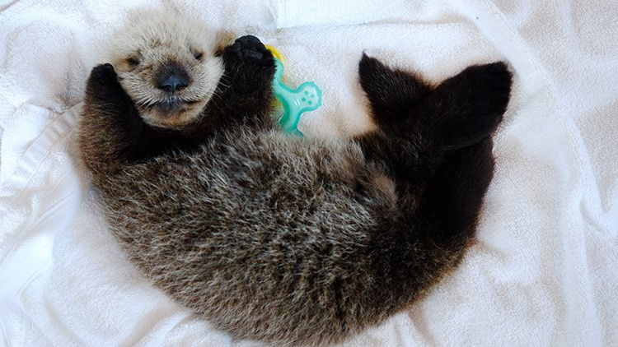

Attendance
links.cs61a.org/chris-disc
Magic Word: objection

Slide 25
Flying the cOOP
class Bird:
def __init__(self, can_fly, call):
self.can_fly = can_fly
self.call = call
def sing(self):
print(self.call)
class SilentBird:
def __init__(self, can_fly, call):
self.can_fly = can_fly
self.call = call
def sing(self):
print(‘’)

Slide 26
Inheritance!
class Bird:
def __init__(self, can_fly, call):
self.can_fly = can_fly
self.call = call
def sing(self):
print(self.call)
class SilentBird(Bird):
def sing(self):
print(‘’)

Slide 27
Method/Attribute Lookup
Parent
Class
Class
Instance

